Slide 1
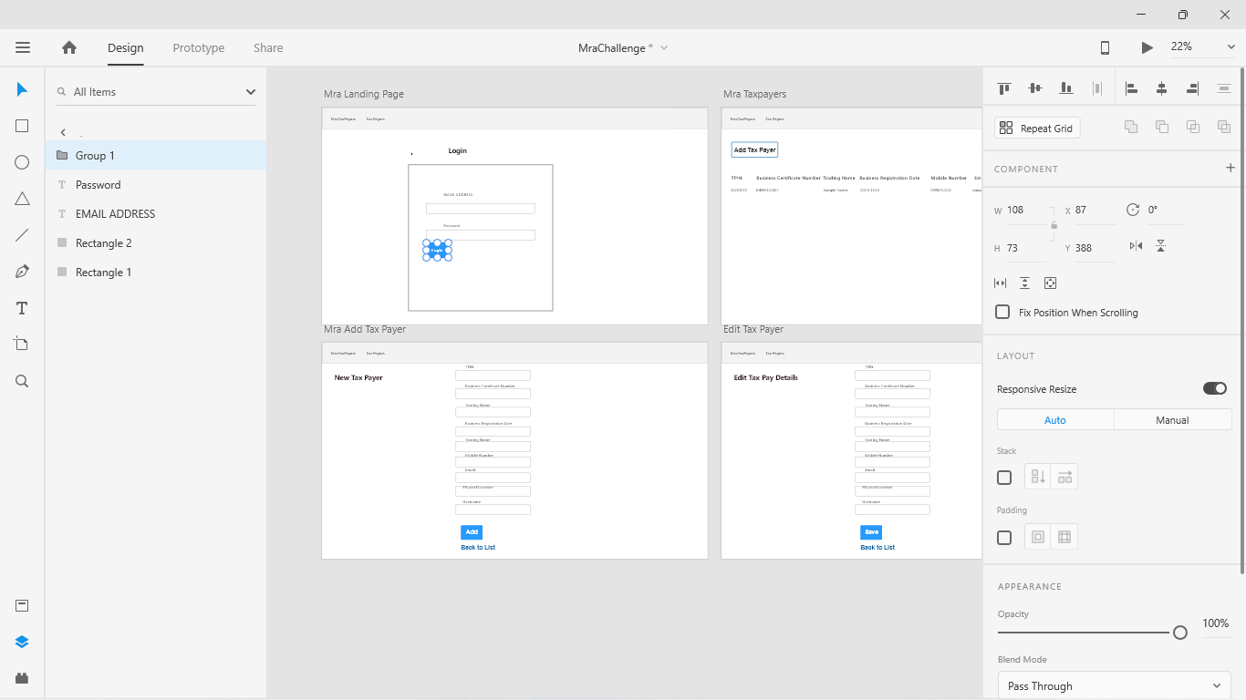
Mra Challenge
Jacob’s
Design

Slide 2
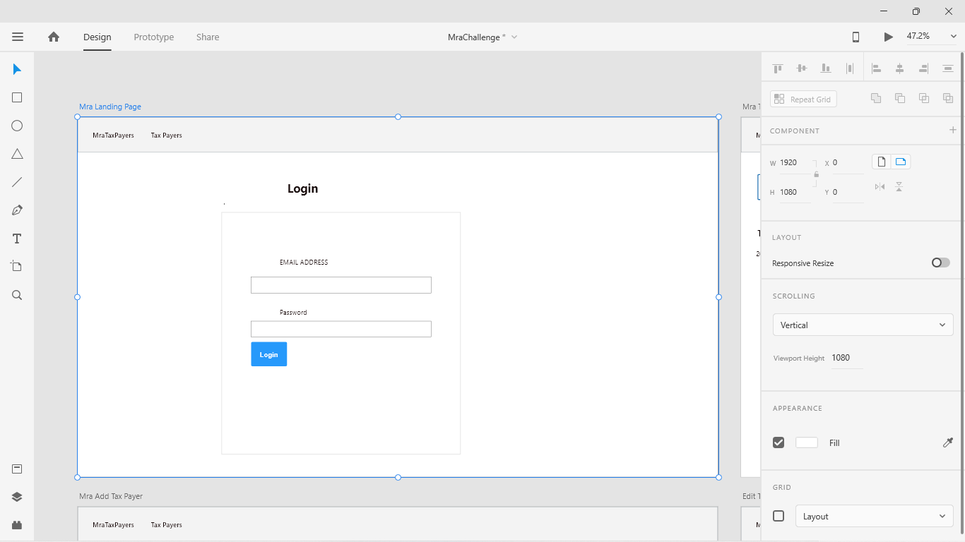
Mra Challenge
Design

Slide 3
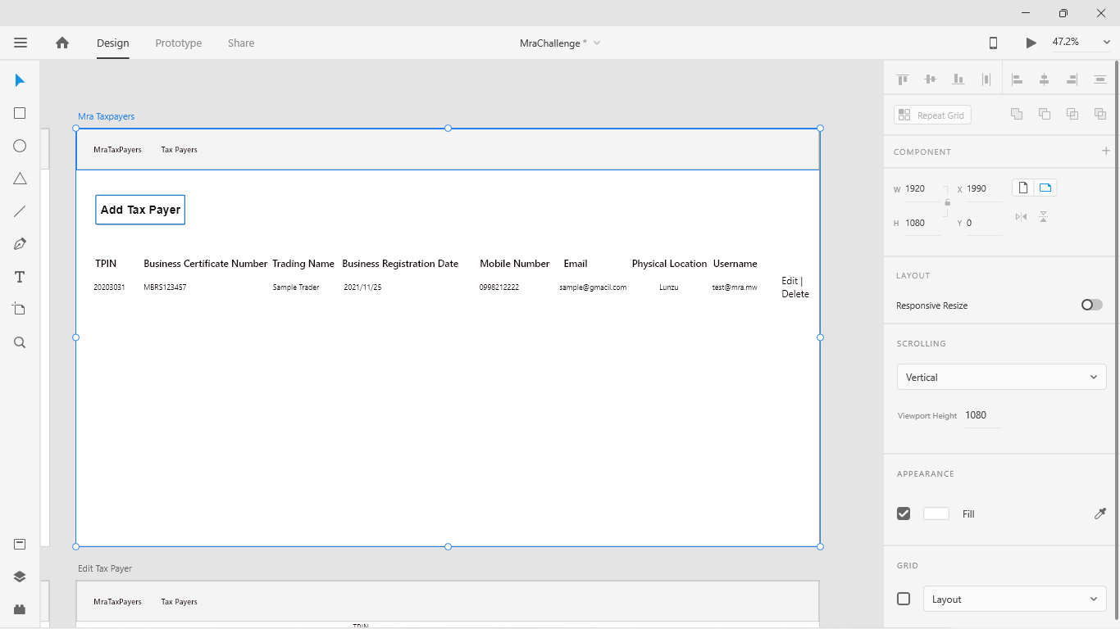
Mra Challenge
Design

Slide 4
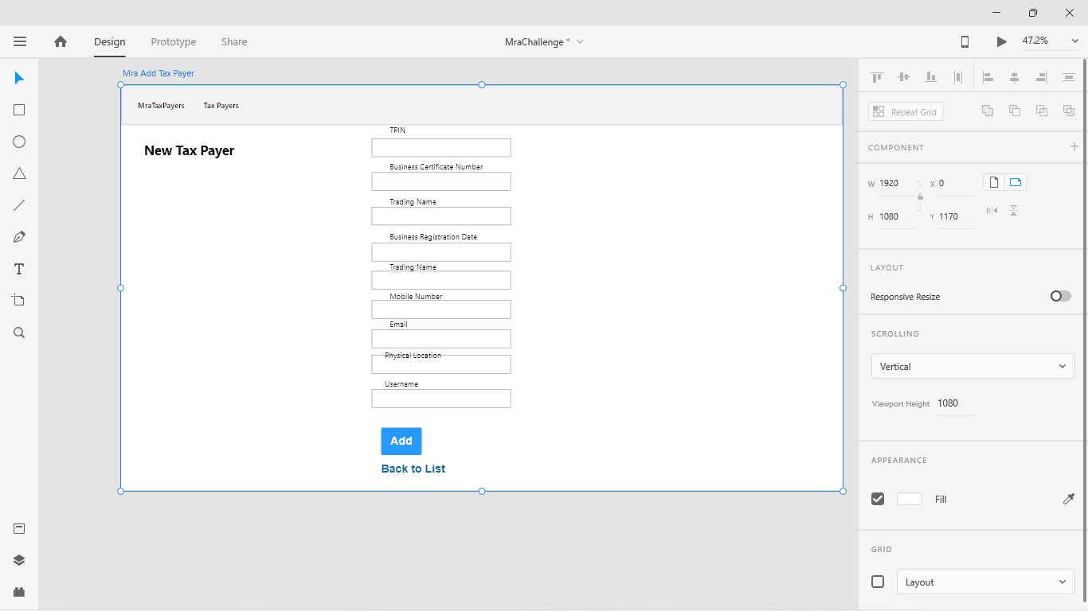
Mra Challenge
Design

Slide 5
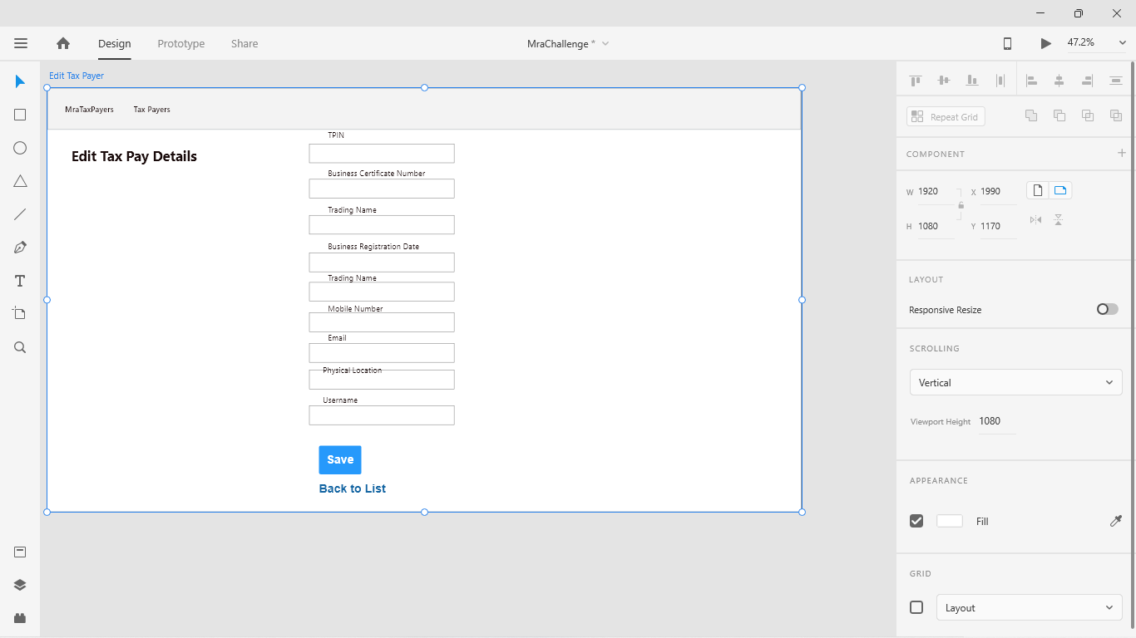
Mra Challenge
Jacob’s
Design

Slide 6
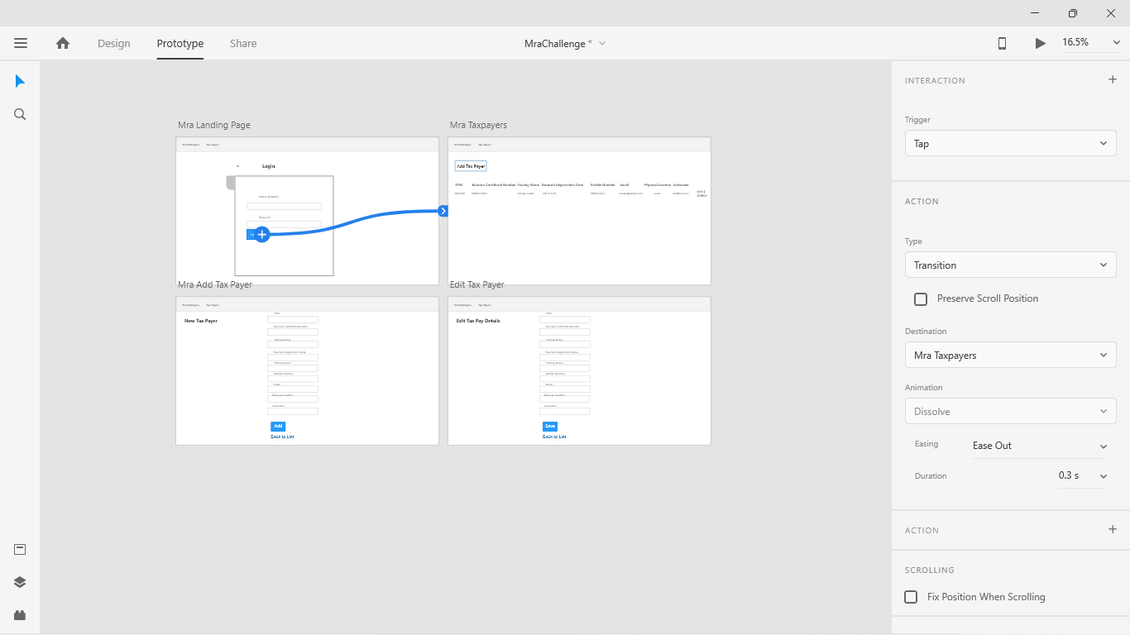
Mra Challenge
Jacob’s
Live Prototyping

Slide 7
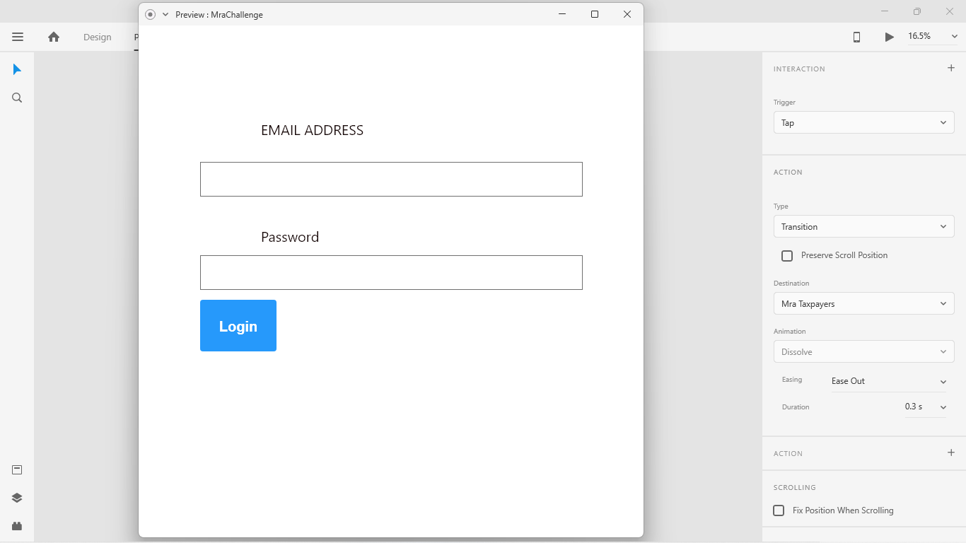
Mra Challenge
Jacob’s
Live Prototyping

Slide 8
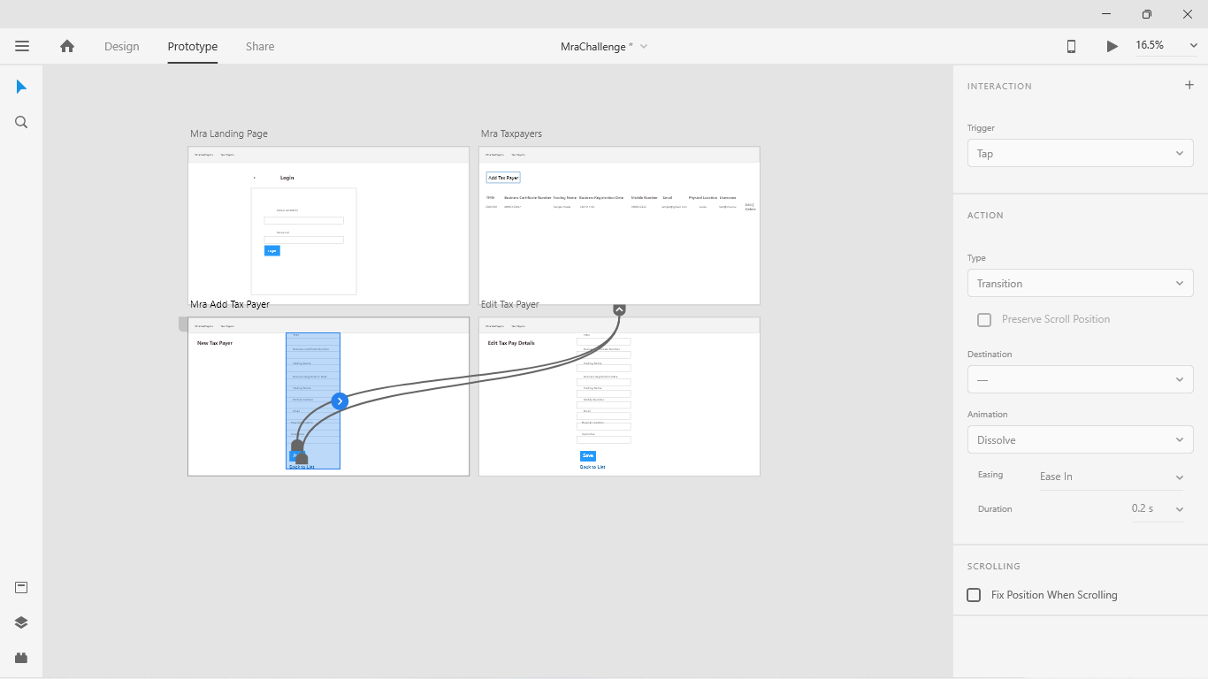
Mra Challenge
Jacob’s
Live Prototyping

Slide 9
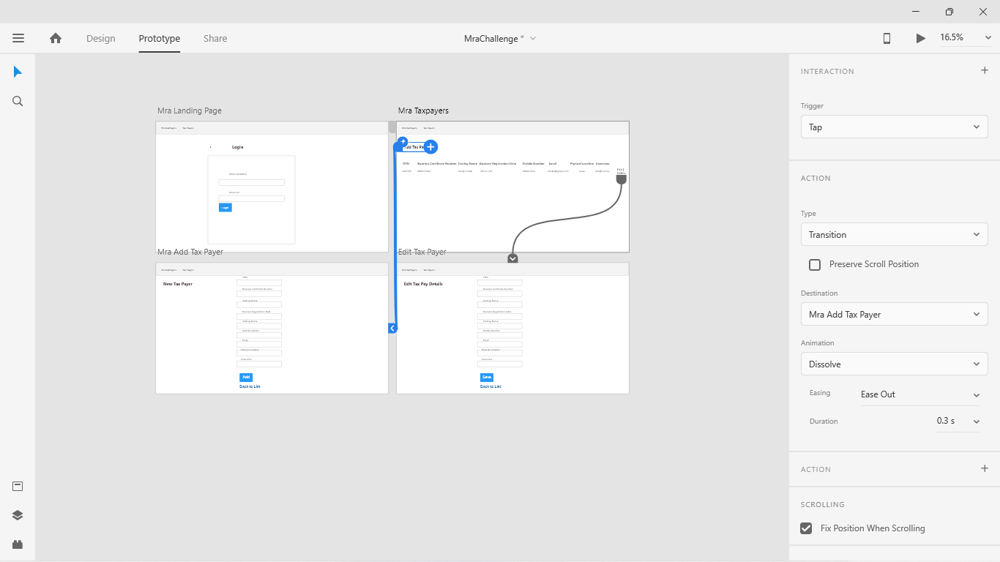
Mra Challenge
Jacob’s
Live Prototyping

Slide 10
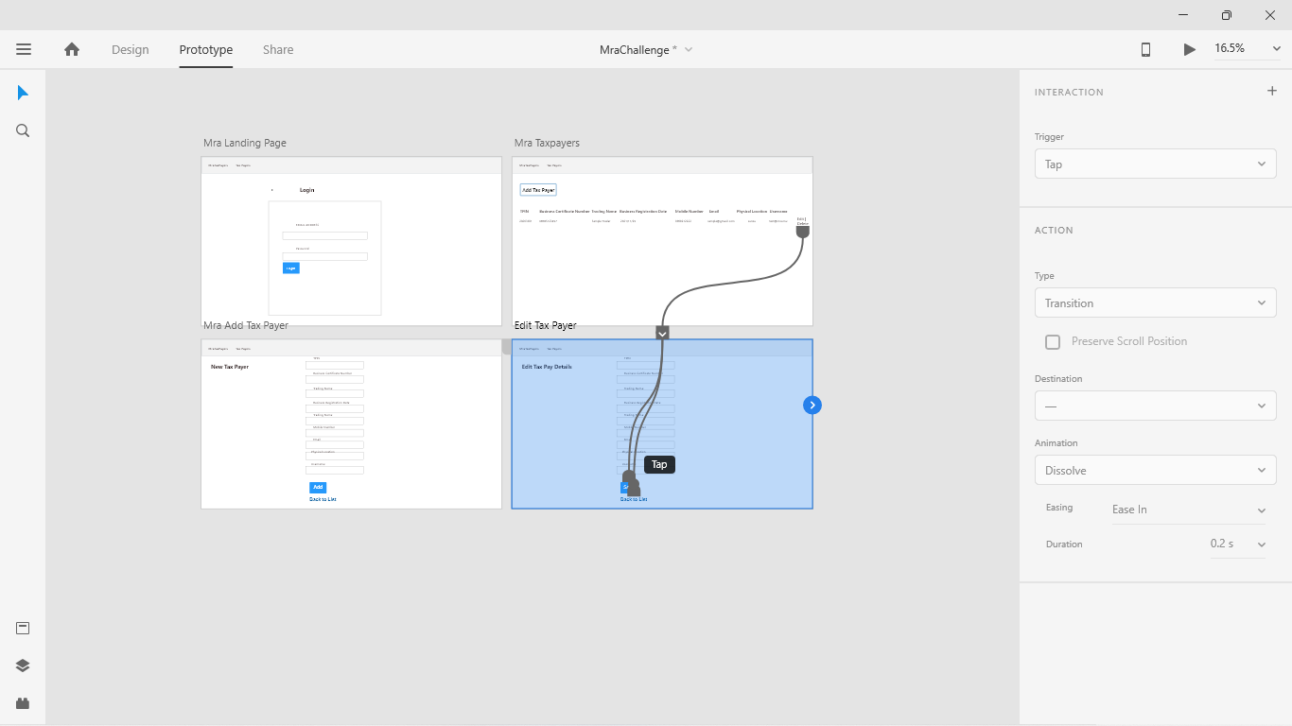
Mra Challenge
Jacob’s
Live Prototyping

